Slide 1
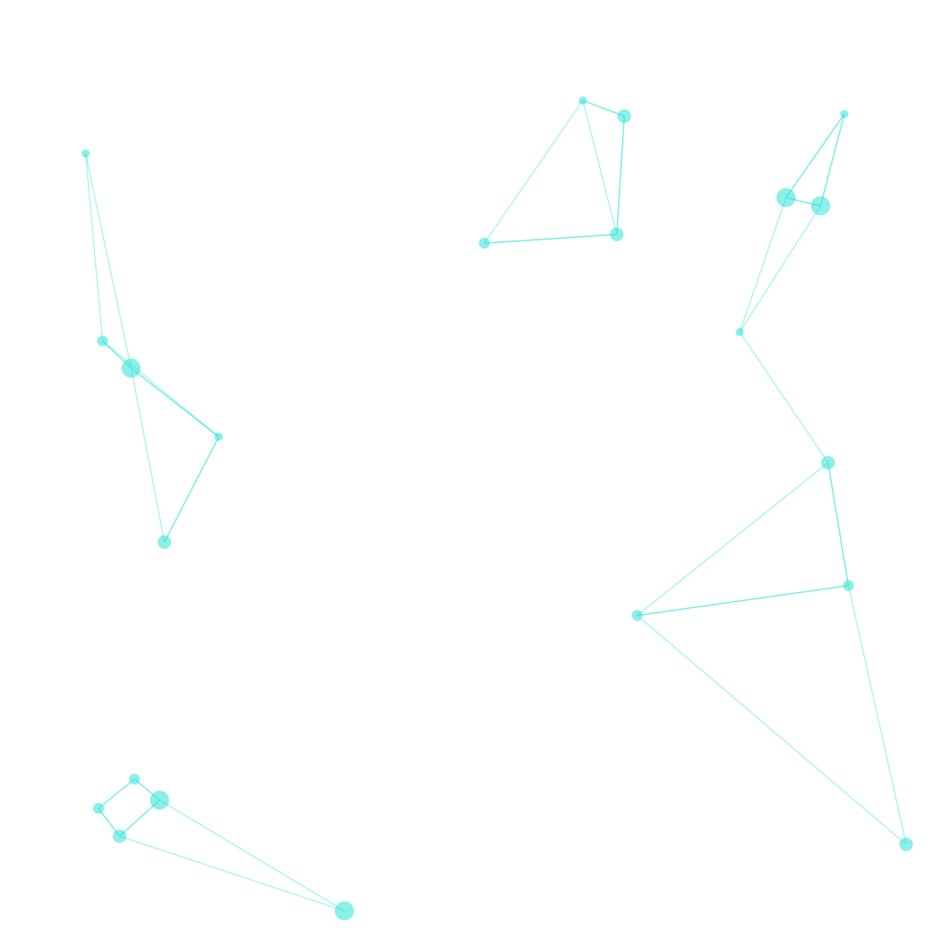



Brain Tumor Classification
Deep Learning, Transfer Learning & Grad-CAM Explainability
Presented by
ENG : Mahmoud Khaled Elsayed Nabawy
1 / 19

Slide 2

Presentation Plan
▸ 01 Dataset & EDA 3,264 MRI scans across 4 tumor classes.
▸ 02 Data Pipeline Pre-processing, augmentation & stratified split.
▸ 03 Custom CNN Baseline Lightweight 4-block CNN built from scratch.
▸ 04 Transfer Learning MobileNetV2 fine-tuned for clinical accuracy.
▸ 05 Training & Metrics Loss/accuracy curves, latency & model size.
▸ 06 Clinical Evaluation Precision, recall & confusion matrix analysis.
▸ 07 Explainability Grad-CAM heatmaps for lesion localization.
▸ 08 Conclusion Key takeaways & clinical impact.
2 / 19

Slide 3
Project Overview
▸ Objective: Automate multi-class brain tumor detection from MRI scans using deep learning.
▸ Dataset: 3,264 T1-weighted MRI images (Glioma, Meningioma, Pituitary, No Tumor).
▸ Approach: Compare a custom CNN baseline against a fine-tuned MobileNetV2.
▸ Explainability: Apply Grad-CAM to visualize model attention on tumor regions.
▸ Hardware: NVIDIA RTX 4060 Laptop GPU with Keras PyTorch backend.
3 / 19

Slide 4
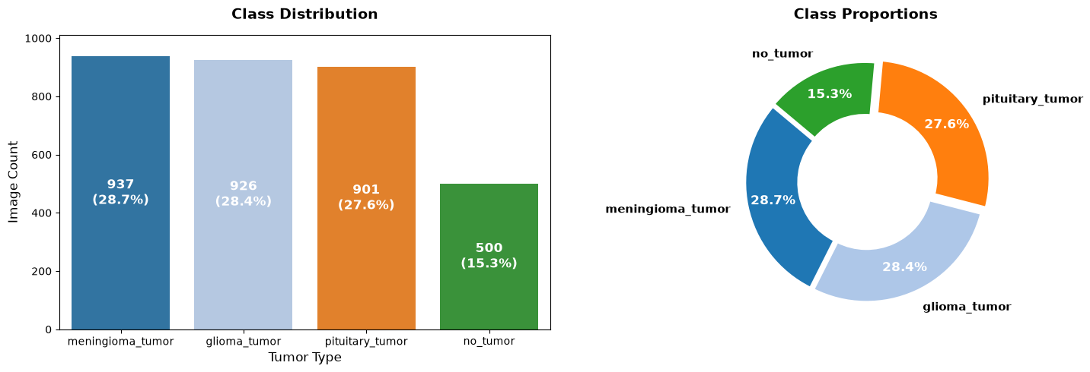
Dataset & Class Distribution
▸ Total Images: 3,264 indexed MRI scans.
▸ Classes: Glioma (926), Meningioma (937), No Tumor (500), Pituitary (901).
▸ Imbalance: No Tumor is under-represented; balanced class weights applied.
▸ Source: Combined Training & Testing folders into unified DataFrame.
4 / 19

Slide 5
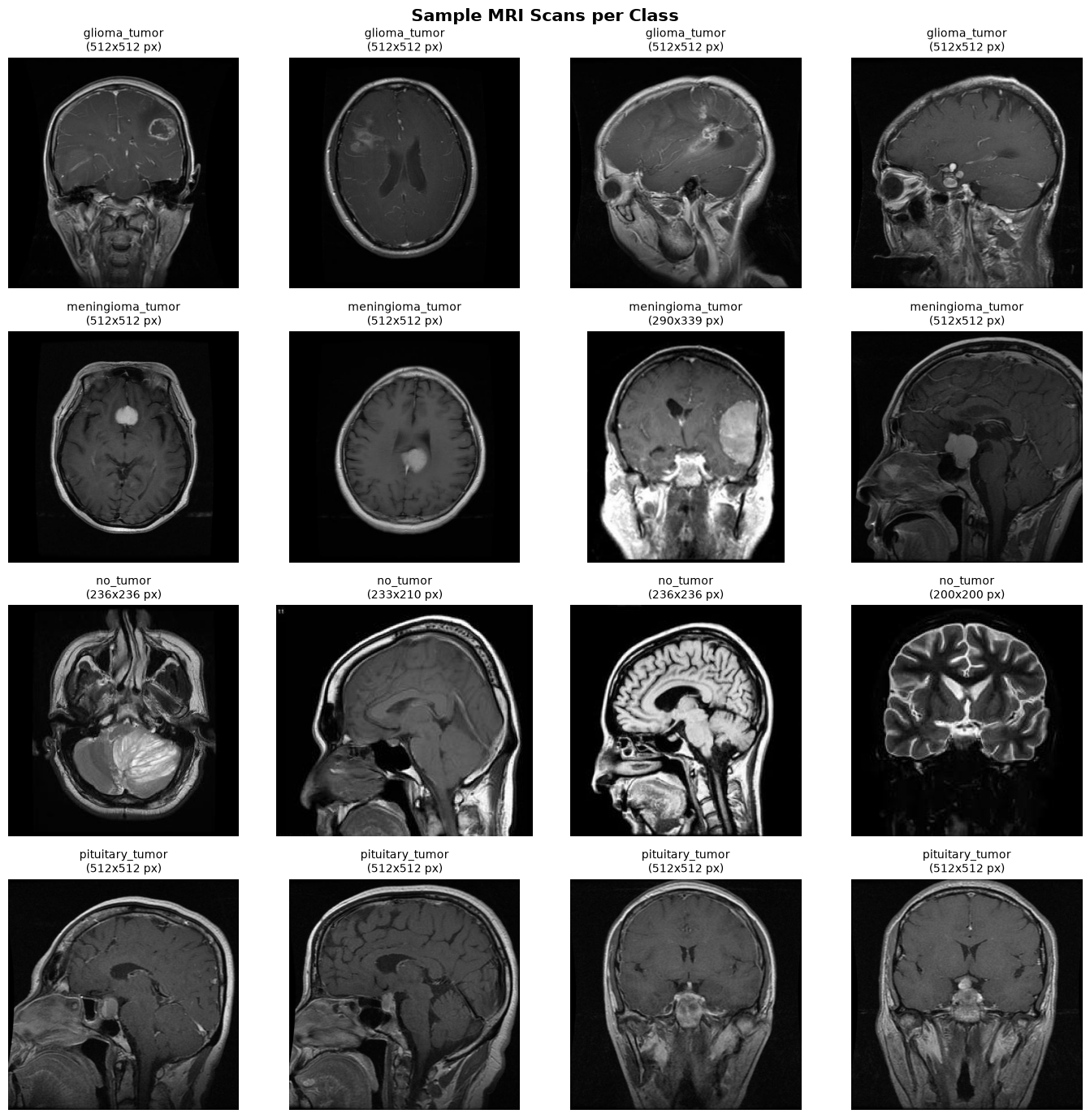
Sample MRI Scans
Representative scans for each class with native resolution preserved.
5 / 19

Slide 6
Stratified Data Split
# 70 / 15 / 15 stratified split
train_df, temp_df = train_test_split(df, test_size=0.30,
random_state=SEED, stratify=df['label_idx'])
val_df, test_df = train_test_split(temp_df, test_size=0.50,
random_state=SEED, stratify=temp_df['label_idx'])
print(f"Train: {len(train_df)} ({len(train_df)/len(df)*100:.1f}%)")
print(f"Val: {len(val_df)} ({len(val_df)/len(df)*100:.1f}%)")
print(f"Test: {len(test_df)} ({len(test_df)/len(df)*100:.1f}%)")
▸ Stratify: Preserves class ratios across Train / Val / Test.
▸ Reproducibility: Fixed random seed (42) for deterministic splits.
▸ Validation: Used for early stopping and hyper-parameter tuning.
6 / 19

Slide 7
Input Pipeline & Augmentation
def medical_augment(image, label):
image = tf.image.random_flip_left_right(image, seed=SEED)
crop_size = int(IMAGE_SIZE[0] * 0.95)
image = tf.image.random_crop(image, size=[crop_size, crop_size, 3], seed=SEED)
image = tf.image.resize(image, IMAGE_SIZE)
image = tf.image.random_brightness(image, max_delta=0.03, seed=SEED)
image = tf.clip_by_value(image, 0.0, 1.0)
return image, label
▸ Resize: All images normalized to 224×224.
▸ Anatomically Safe: Only horizontal flips & mild brightness shifts.
▸ Normalization: Pixel values scaled to [0, 1].
▸ tf.data: Efficient streaming pipeline with prefetch & caching.
7 / 19

Slide 8
Custom CNN Baseline
def build_custom_cnn(input_shape=(224, 224, 3), num_classes=4):
inputs = layers.Input(shape=input_shape)
x = layers.Conv2D(32, 3, padding='same', activation='relu')(inputs)
x = layers.MaxPooling2D(2)(x)
x = layers.Conv2D(64, 3, padding='same', activation='relu')(x)
x = layers.MaxPooling2D(2)(x)
x = layers.Conv2D(128, 3, padding='same', activation='relu')(x)
x = layers.MaxPooling2D(2)(x)
x = layers.Conv2D(256, 3, padding='same', activation='relu', name="conv4_last")(x)
x = layers.MaxPooling2D(2)(x)
x = layers.GlobalAveragePooling2D()(x)
x = layers.Dropout(0.4)(x)
outputs = layers.Dense(num_classes, activation='softmax')(x)
return models.Model(inputs, outputs)
▸ Architecture: 4 convolutional blocks + GAP + Dropout(0.4).
▸ Parameters: Lightweight; fast inference on edge GPU.
▸ Grad-CAM Hook: conv4_last layer used for attention maps.
8 / 19

Slide 9
Transfer Learning — MobileNetV2
base_model = MobileNetV2(weights='imagenet', include_top=False,
input_shape=(224, 224, 3))
base_model.trainable = False
x = layers.Rescaling(scale=2.0, offset=-1.0)(inputs)
x = base_model(x, training=False)
x = layers.GlobalAveragePooling2D()(x)
x = layers.BatchNormalization()(x)
x = layers.Dense(128, activation='relu')(x)
x = layers.Dropout(0.3)(x)
outputs = layers.Dense(4, activation='softmax')(x)
▸ Pre-trained: ImageNet weights as feature extractor.
▸ Head: Custom dense head with BatchNorm & Dropout(0.3).
▸ Rescaling: Aligns input range to [-1, +1] for MobileNetV2.
9 / 19

Slide 10
Fine-Tuning Phase
base_mobilenet.trainable = True
fine_tune_at = len(base_mobilenet.layers) - 30
for layer in base_mobilenet.layers[:fine_tune_at]:
layer.trainable = False
model_tl.compile(
optimizer=optimizers.Adam(learning_rate=1e-5),
loss='sparse_categorical_crossentropy',
metrics=['accuracy'])
history_tl_phase2 = model_tl.fit(
train_ds, validation_data=val_ds,
epochs=8, callbacks=callbacks_tl,
class_weight=class_weights_dict)
▸ Strategy: Unfreeze top 30 layers; freeze lower feature layers.
▸ LR: Low learning rate (1e-5) to avoid catastrophic forgetting.
▸ Class Weights: Mitigates imbalance during fine-tuning.
10 / 19

Slide 11
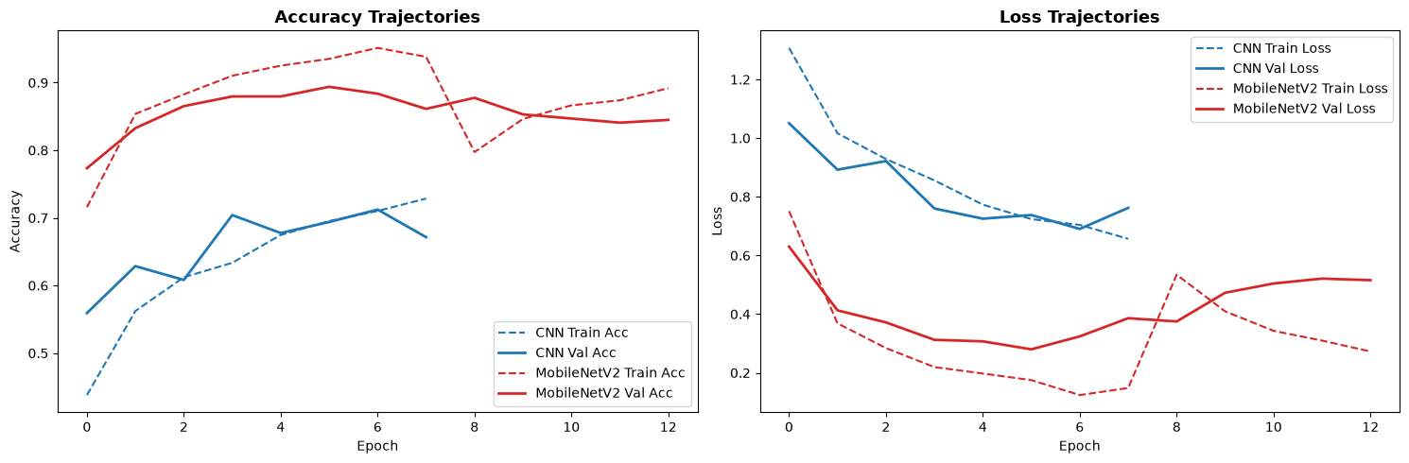
Training History Comparison
Left: Custom CNN | Right: MobileNetV2 Transfer Learning — Accuracy & Loss curves.
11 / 19

Slide 12
Model Size & Inference Latency
Model | Disk Size | Avg Inference Time
Custom CNN | 78.01 MB | 3.17 ms
MobileNetV2 | 22.78 MB | 44.65 ms
MobileNetV2 is 3.4× smaller but slower due to depthwise-separable convolutions on GPU.
12 / 19

Slide 13
Clinical Evaluation — Classification Reports
Metric | Custom CNN | MobileNetV2 | Δ
Accuracy | 67.35% | 83.88% | +16.53%
Macro Recall | 67.35% | 83.88% | +16.53%
Fine-tuned MobileNetV2 shows a strong clinical gain in both accuracy and recall.
13 / 19

Slide 14
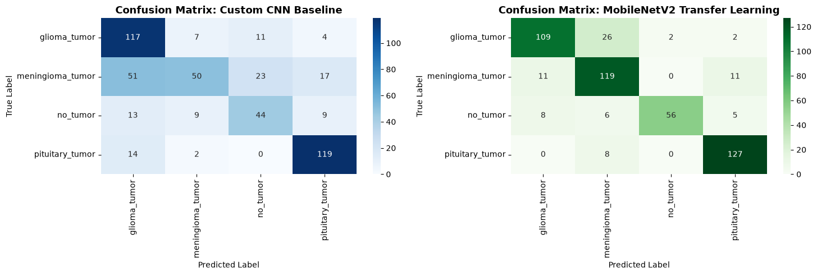
Confusion Matrix & Error Analysis
Left: Custom CNN | Right: MobileNetV2 — Reduced misclassifications across all tumor classes.
14 / 19

Slide 15
Benchmarking Summary
▸ Best Model: Fine-tuned MobileNetV2 (83.88% accuracy).
▸ Key Win: +16.53% absolute improvement over custom CNN.
▸ False Negatives: Critical metric for diagnosis; MobileNetV2 reduces FN rate significantly.
▸ Deployment: 22.78 MB model fits edge/mobile constraints.
▸ Trade-off: Slightly higher latency (44.65 ms) acceptable for clinical batch processing.
15 / 19

Slide 16
Grad-CAM Explainability
def make_gradcam_heatmap(img_array, model, last_conv_layer_name):
grad_model = models.Model(
inputs=model.input,
outputs=[model.get_layer(last_conv_layer_name).output,
model.output])
conv_out, preds = grad_model(img_tensor)
class_score = preds[0, pred_index]
grads = torch.autograd.grad(class_score, conv_out)[0]
pooled_grads = torch.mean(grads, dim=(0, 1, 2))
heatmap = conv_out[0] @ pooled_grads.unsqueeze(-1)
heatmap = torch.relu(heatmap)
heatmap = heatmap / (torch.max(heatmap) + 1e-10)
return heatmap
▸ Purpose: Visualize where the model looks in the MRI.
▸ Method: Gradient-weighted class activation mapping on last conv layer.
▸ Overlay: Heatmap superimposed on original scan for radiologist review.
16 / 19

Slide 17
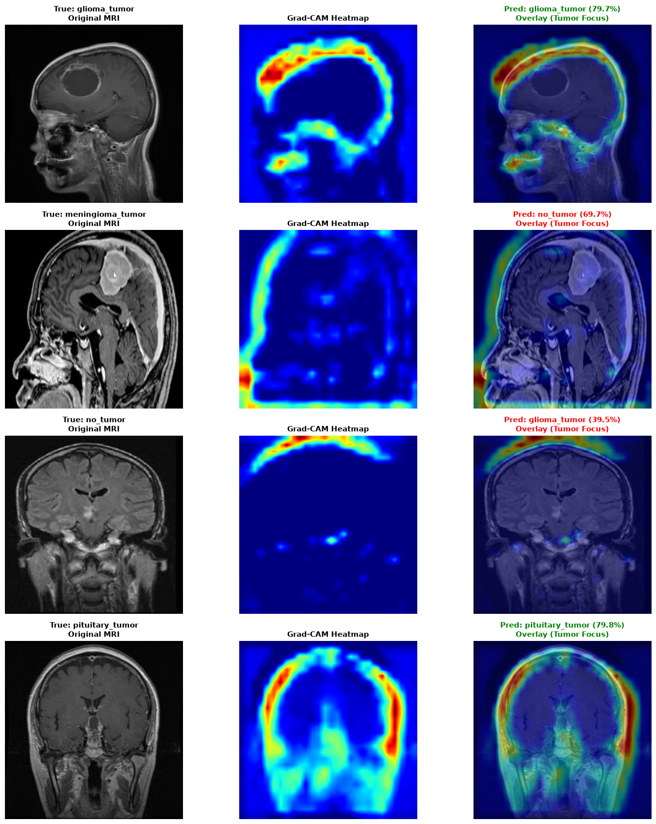
Grad-CAM Lesion Localization
Heatmaps align with actual tumor regions, validating model decisions for clinical trust.
17 / 19

Slide 18
Conclusion & Clinical Takeaways
▸ Accuracy: MobileNetV2 fine-tuning reached 83.88% on 4-class brain tumor classification.
▸ Efficiency: 22.78 MB footprint enables deployment on clinical workstations & edge devices.
▸ Trust: Grad-CAM provides transparent, interpretable predictions for radiologists.
▸ Next Steps: 3D volumetric models, multi-sequence MRI fusion, and real-time inference APIs.
18 / 19

Slide 19

Thank You
Questions & Discussion
19 / 19

